Slide 1

Introduce to Linux
Yao-Tung Tsou

Slide 2
Operating System (OS)
A program or a software that governs the functioning of other programs
Interface between User and the Hardware
Allocates resources for tasks
Allocates tasks to programs
Manages space and time
Controls the devices

Slide 3
History
Multics – 1964
Unics – 1969
Minix – 1990
Linux – 1991

Slide 4
Multics
Multiplexed Information and Computing Service
Written in 1964
Timesharing OS
Last version was shut down on October 30, 2008
Monolithic kernel
Notes:
A monolithic kernel is an operating system architecture where the entire operating system is working in kernel space and is alone in supervisor mode. The monolithic model differs from other operating system architectures (such as the microkernel architecture)^{[1][2]} in that it alone defines a high-level virtual interface over computer hardware. A set of primitives or system calls implement all operating system services such as process management, concurrency, and memory management. Device drivers can be added to the kernel as modules.

Slide 5
Unics
Uniplexed Information and Computing System
Later renamed as UNIX
Written in 1969
Ken Thompson, Dennis Ritchie were among the developers
Multi user, Multi tasking and timesharing
Monolithic kernel

Slide 6
Minix
Minimal Unix
Tanenbaum developed this OS
Mainly for educational purpose
Unix like OS, implemented with Micro kernel. So the name Minix

Slide 7
Linux
Developed in 1991 by Linus Torvalds
Used in most of the computers, ranging from super computers to embedded system
Multi user
Multi tasking
Time sharing
Monolithic kernel
Notes:
Latest stable version of linux kernel – 2.6.28, released on 24-Dec-2008

Slide 8
Background on Linux
Version of UNIX
Linus Torvalds – Creator of Linux
Open Source Operating System
Free Open Source Software (FOSS)
Source Code Available

Slide 9
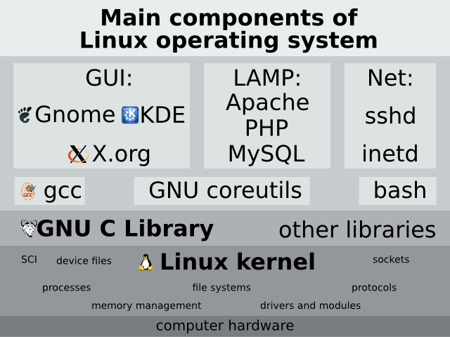
Linux OS
Notes:
GUI: graphical user interface
KDE 和 Gnome 的地位是一樣的，他們同樣是桌面環境。桌面環境簡言之即是一般使用者面對電腦的軟體介面，他包含了圖形、操作方法（如視窗的概念）、硬體管理、提供應用程式表現的方式……等，族繁不及備載。
LAMP是指一組通常一起使用來執行動態網站或者伺服器的自由軟體名稱首字母縮寫(abbreviation)
inetd (internet service daemon) is a super-server daemon on many Unix systems that provides Internet services.
至於 Linux 使用的這一種版本就稱為『 Bourne Again SHell (簡稱 bash) 』
第一個流行的 shell 是由 Steven Bourne 發展出來的，為了紀念他所以就稱為 Bourne shell
sshd (OpenSSH Daemon) is the daemon program for ssh

Slide 10
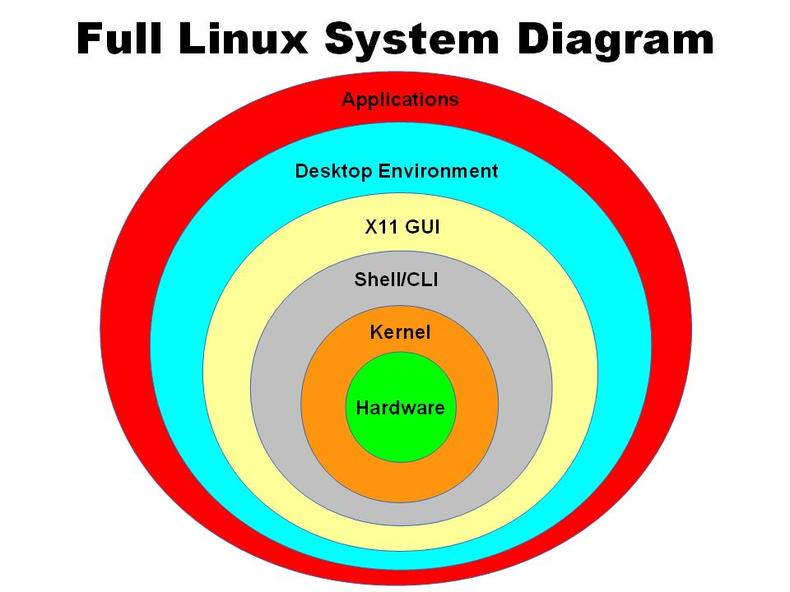
Kernel
Core or nucleus of an operating system
Interacts with the hardware
First program to get loaded when the system starts and runs till the session gets terminated
Different from BIOS which is hardware dependent.
Kernel is software dependent

Slide 11
Kernel types
Monolithic
All OS related code are stuffed in a single module
Available as a single file
Advantage : Faster functioning
Micro
OS components are isolated and run in their own address space
Device drivers, programs and system services run outside kernel memory space
Supports modularity
Lesser in size

Slide 12
Shell
Program that interacts with kernel
Bridge between kernel and the user
Command interpreter
User can type command and the command is conveyed to the kernel and it will be executed

Slide 13
Types of Shell
Sh – simple shell
BASH – Bourne Again Shell
DASH – Debian Almquist shell
RBASH – Restricted Shell
SSH – Secure Shell protocol
To view the available shells in the system, type cat /etc/shells at the command prompt
To view the current shell that is being used, type echo $SHELL at the command prompt
Notes:
Bash is a Unix shell and command language written by Brian Fox for the GNU Project as a free software replacement for the Bourne shell.
Dash is an acronym for Debian Almquist shell (dash). It is a Unix and Linux shell which is much smaller than bash
The restricted shell is a Unix shell that restricts some of the capabilities available to an interactive user session, or to a shell script, running within it.

Slide 14
Where is Linux Used?
75% of respondents were already using Linux and another 14% were evaluating it
43% of all web sites use Linux servers running the Apache Web server

Slide 15
How is Linux Used?
Personal Workstation
File and Print Server
Internet Service Provider
Three-tier Client/Server
Turnkey System

Slide 16
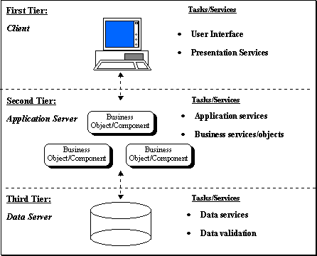
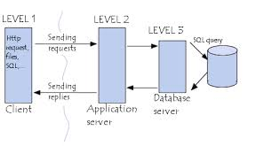
Three-tier Client/Server

Slide 17
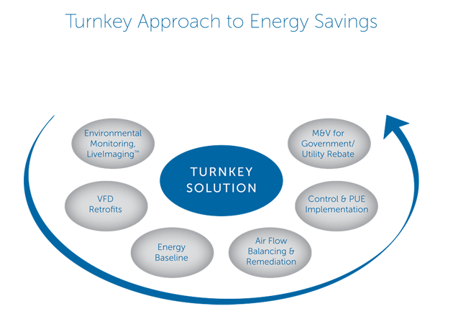
Turnkey System
A computer system that is setup or designed to satisfy all the customer's needs. For example, many companies will setup a turnkey system for its employees, this system has all of the necessary hardware and software for the employee to begin working. Because many consumers need to install software or customize their computer, most computers are not considered a turnkey system.
Notes:
VFD (Variable Frequency Drive) Retrofit
Measurement and Verification

Slide 18
Using Linux on Personal Computers
Linux kernel for free
Kernel is central component
Kernel can be customized to user’s needs

Slide 19
Linux Distributions
Corel Linux
Debian GNU/Linux
OpenLinux (Caldera)
Red Hat
Slackware
SuSE
TurboLinux
Raspberry Pi＋Debian Linux (Raspbian)
Arch Linux for Raspberry Pi

Slide 20
Software Applications
OpenOffice: word processing, spreadsheets, drawing
Adobe Acrobat Reader
Konqueror: The KDE File Manager and Web Browser
Kmail: The KDE Mail Application
Evolution: An Email and Calendar Program
Sound Applications
Notes:
KDE is an international team co-operating on development and distribution of Free, Open Source Software for desktop and portable computing.

Slide 21
Software Applications (continued)
TV, Video, Radio, and Webcam
K3b: The KDE Burning Application
Digital Cameras
Kooka: Scanning Application
Graphics with the GNU Image Manipulation Program (GIMP)
Shell system
Notes:
1. 可客製化的界面 ： GIMP可以讓使用者任意變換介面顏色、更改介面位置，更可以全螢幕執行。 2. 圖像強化效果 ： 使用GIMP可以輕易的將數位化的影像進行特殊效果的處理。 3. 硬體支援 ： GIMP支援了許多硬體，如顯示卡或透過USB隨插及用硬體等，可加速軟體工作效率。 4. 多檔案格式 ： GIMP支援了多種的檔案格式，如JPEG(JFIF),GIF,PNG,TIFF等，可以以各種格式進行編輯與存取。 5. 多平台支援 ： GIMP可在多種平台上運行，如Linux、Microsoft Windows、Mac OS X、Sun OpenSolaris等等。

Slide 22
Working with the “Shell”
Executes user commands
Command element
Command name
parameters

Slide 23
Linux Directory Structure
Store drives
Accessing data using folders
Root directory:
beginning of file system

Slide 24
Subdirectories
Examples of Subdirectories
/root directory, starting point of the directory tree
/home (private) directories of users
/devDevice files that represent hardware components
/etc Important files for system configuration
/etc/init.d Boot scripts/usr/bin Generally accessible programs

Slide 25
Why Use Linux?
Costs less
Stable
Reliable
Extremely powerful

Slide 26
LINUX VS WINDOWS

Slide 27
Financial Differences
Technical Differences
End-User Differences

Slide 28
Financial Differences

Slide 29
Linux vs. Windows
COST
 | LINUX | WINDOWS
Online Downloads | Free | Not Available
Retail Price, CD | $15 | $150

Slide 30
Cost for Businesses
Companies have to spend millions for licenses for ever individual windows computer
For Linux companies don’t have to spend anything

Slide 31
Technical Differences

Slide 32
Linux vs. Windows
Keeping up to date
By upgrading
Linux upgrades faster than Windows
Compatibility
Linux is backward compatible unlike windows
Both support Dynamic Caching
Both have Multi-user Support

Slide 33
End-user differences

Slide 34
Linux vs. Windows
Application Differences
No commercial word processor for Linux, which matches the quality for Windows
Windows is a Proprietary Technology
Applications will only work on Windows
Linux – Open Source

Slide 35
Linux vs. Windows
Complete information needed for download
Technical help – Available on Internet (user must be comfortable with UNIX system)
Windows word processor is better than Linux

Slide 36
Conclusion
“When is it best to use Linux and when should some other operating system be preferred?”
It all depends on the user

